Slide 1
Information Session

Slide 2
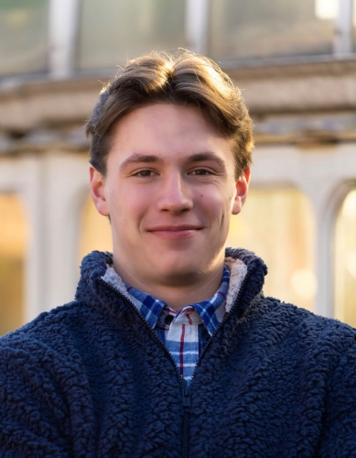
Meet the E-Board
Thomas Sloan
Position: President
Major: Accounting
Favorite Hobby: Golfing
Fun Fact: 4x IM Sports Champion

Slide 3
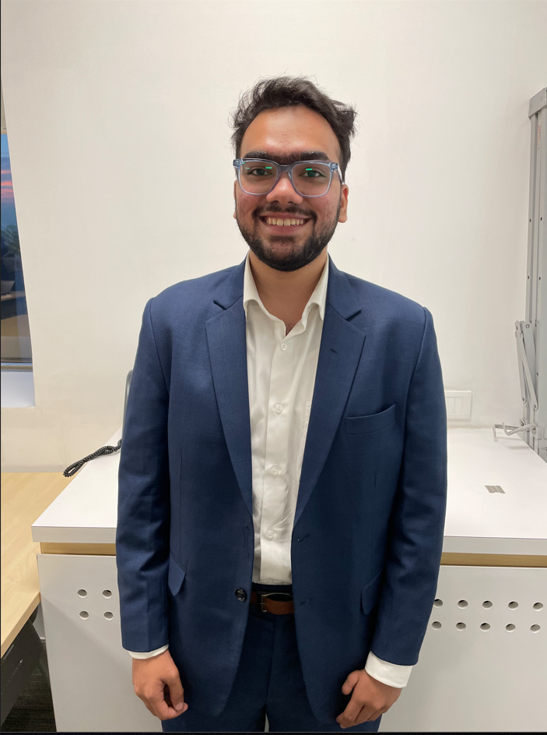
Meet the E-Board
Naman Mall
Position: Vice President
Major: Accounting
Favorite Hobby: Watching movies and reading
Fun Fact: I watched 120 movies in 3 months during COVID

Slide 4
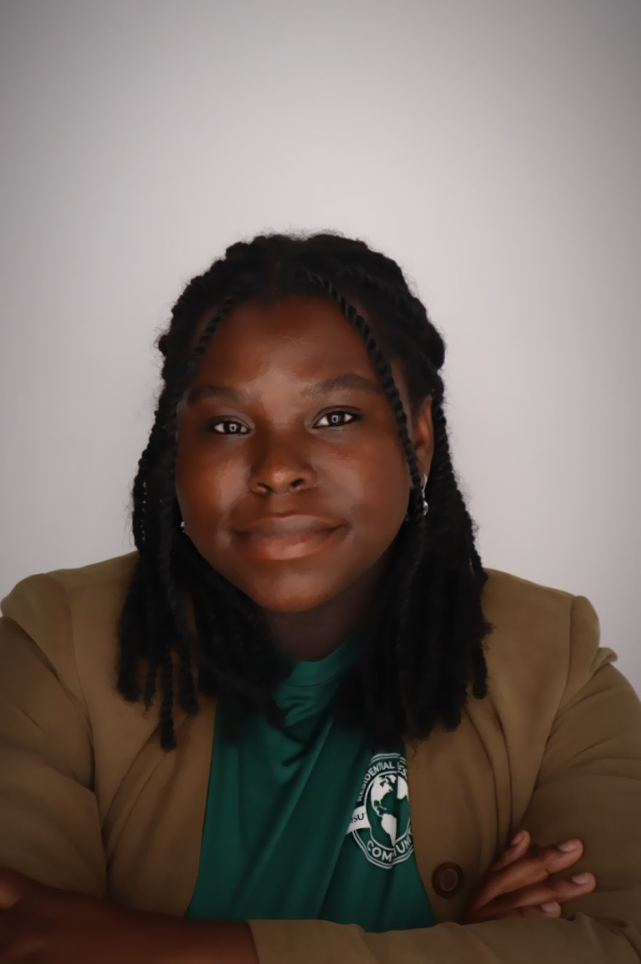
Meet the E-Board
Minnie Davis-Konamah Asare
Position: Treasurer
Major: Accounting
Favorite Hobby: Photography
Fun Fact: This is my first year celebrating Halloween!

Slide 5
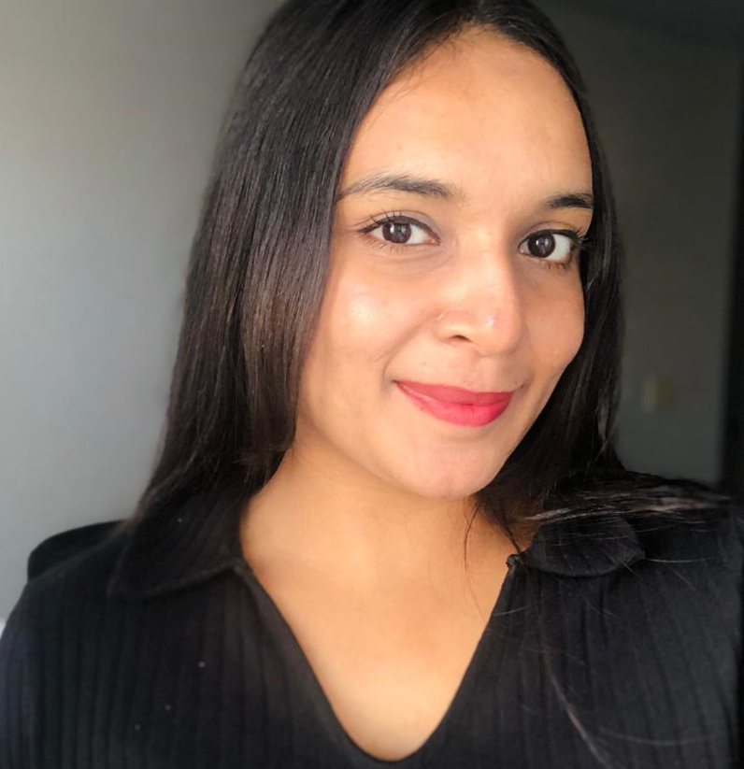
Meet the E-Board
Oviya Senthil Kumar
Position: Secretary
Major: Accounting
Favorite Hobby: Reading
Fun Fact:

Slide 6
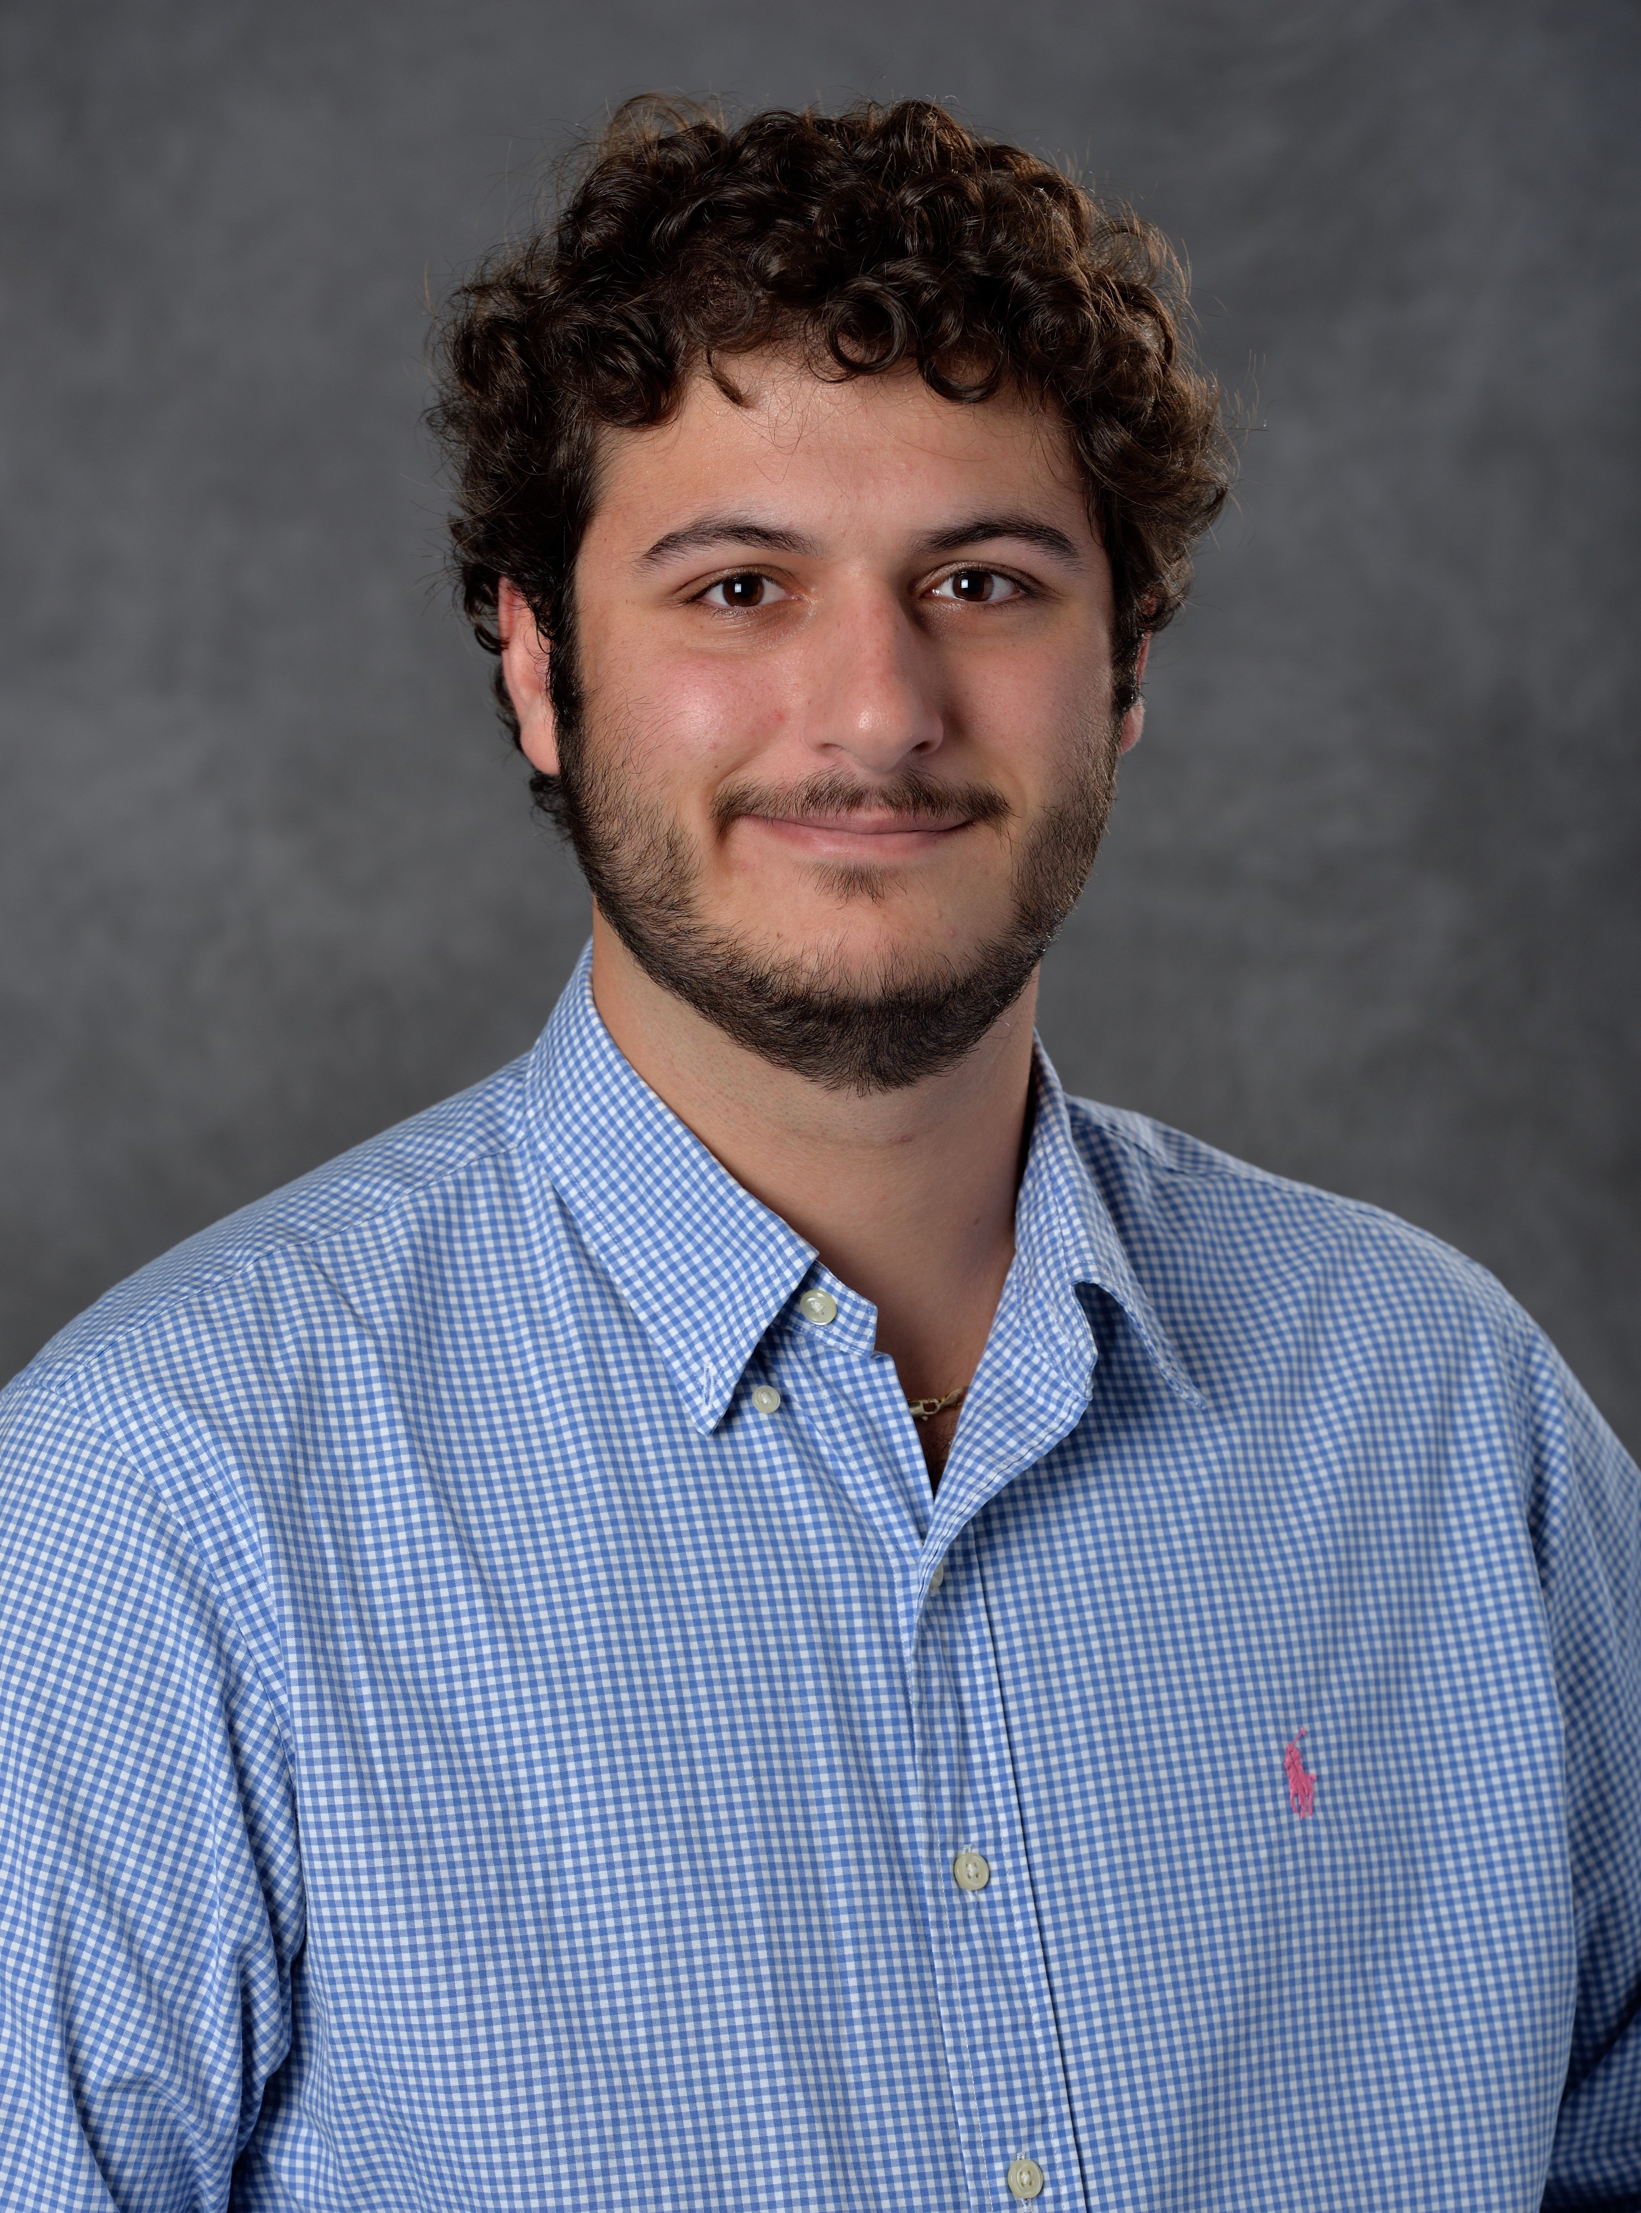
Meet the E-Board
Anthony Curcuru
Position: Public Relations Manager
Major: Accounting
Favorite Hobby: Playing Hockey
Fun Fact: I live on an island

Slide 7
What is VITA?
Program offered by the IRS in partnership with community partners
12,000 sites operating across the country
Provide income tax return assistance for households with low to moderate income
Over 1 million returns are filed by VITA programs
During the 2022 tax season, more than $6 million in economic benefit was provided to the community

Slide 8
Traditional Service
Client schedules an appointment with 2-1-1
They arrive on site and complete intake forms
Preparer reviews forms and begins entering information into tax software (TaxSlayer)
Return is completed and a quality reviewer double checks the information
Return is reviewed with client and transmitted if everything is correct

Slide 9
Hybrid/Virtual
Client works with intake specialist who scans and uploads tax documents and completed intake forms. (For virtual, this happens remotely)
These documents are accessible by remote volunteers for preparation and quality review.

Slide 10
Provide support to our Lansing community
Through quality tax service
Deliver excellent customer service
Through a kind, professional experience!
Our external mission

Slide 11
Provide you with professional experience
Face to face interaction with clients
Useful 1040 knowledge
Recruiters love VITA!
Give our volunteers a way to give back the community!
Our Internal Mission

Slide 12
Volunteer
Positions
Intake Specialist
Lead the intake process & communicate with clients
Basic Tax Preparer
Complete client tax return with info provided
Quality Reviewer
Review tax return completed by basic preparer and make sure site runs smoothly (for returning volunteers only)
Notes:
Dana - updated on VITA website

Slide 13
Volunteering & Site Operations
Volunteer Requirements:
3-4 hours per week during tax season
Intake specialists volunteer on-site
Tax preparers can work remotely at any time or in person during the day/evening

Slide 14
Transportation Options
Many volunteers drive or carpool
Site is accessible through bus routes 1 to Lansing and 2 down S Washington Ave
Can volunteer virtually!

Slide 15
Timeline
Training
Total of 5-15 hours depending on your comfort level with taxes and volunteer role you choose through UWSCMI’s online platform
Exam
Due at the end of January
Volunteering
End of January - April 15th
Flexible, learn whenever you like/are able to!
Optional live sessions
We are accessible and want to help! November 2023 - January 2024

Slide 16
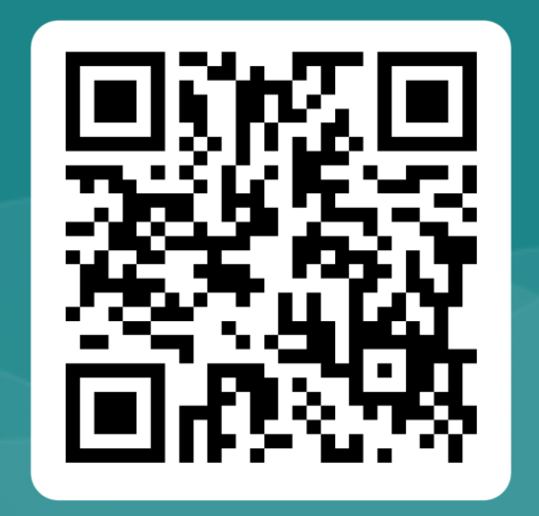
Our Email
If you would like to keep in contact with us, please reach out to rso.msuvita@msu.edu to sign up for our email list or go to the https://forms.office.com/r/nzaHVfMegg or scan the QR code.

Slide 17
Volunteer Sign Up
https://bttr.im/oljuo

